Slide 1
Design and analysis of algorithms
Weiwei Wu(吴巍炜)

Slide 2
Design and analysis of algorithms
-- Introduction to Algorithmic Thinking
Weiwei Wu(吴巍炜)

Slide 3
Mobile System, mechanism design and competitiveness
Weiwei Wu(吴巍炜)
http://cse.seu.edu.cn/people/weiweiwu
About me
CityU
USTC
2011, PhD, Hong Kong
NTU
2012, Postdoc, Singapore
SEU
2012, Associate professor
weiweiwu@seu.edu.cn
Notes:
Combinatorial Optimization in Action
Flying a plane, riding a bus, buying a writing pad, or making a
phone call: Can you imagine that combinatorial optimization has
something to do with these activities? This lecture will provide
answers and show how the techniques of discrete mathematics
influence our daily life.
Combinatorial optimization in action
Combinatorial optimization exploded on the mathematical and scientific scene in the 1950s. In this lecture I will briefly survey its development for a wide audience. Theoretical design and analysis of algorithms dominated the early development of the field, while computational progress has been particularly significant in the last twenty years. These theoretical and computational achievements, combined with successful modeling of applications, have made it possible today to solve real-world problems of breathtaking size and diversity. The majority of the lecture will report on success stories in areas such as telecommunication, transportation, traffic and logistics. These results are based on ongoing cooperation between industry, the DFG Research Center MATHEON and my research group at Konrad-Zuse-Zentrum (ZIB).

Slide 4
Studied topics: ALG in computer science
wireless communication
cloud computing
green computation techniques
crowdsourcing/ride sharing
auction and network economics
reinforcement learning
…
About me

Slide 5
Where have we been？

Slide 6
History
    Pioneer: Alan. Turing，Von. Neumann
    Donald Knuth
        A. Turing, On Computable Numbers, with an Application to the Entscheidungsproblem, 1936
        V. Neumann, First Draft of a Report on the EDVAC, 1945
    Given an array, find all “median numbers”
      For which the number before it is smaller and the number after it is larger
  Reading
  100 people
  1 light bulb in a room
  Light off
  System: call each to access the room
  Q: How to design protocol to index that all people have accessed
Think in another way

Slide 7
History
    Pioneer: Alan. Turing，Von. Neumann
    Donald Knuth
        A. Turing, On Computable Numbers, with an Application to the Entscheidung sproblem, 1936
        V. Neumann, First Draft of a Report on the EDVAC, 1945
        D. Knuth,《The Art of Computer Programming》
    Given an array, find all “median numbers”
      For which the number before it is smaller and the number after it is larger
  Reading
  100 people
  1 light bulb in a room
  Light off
  System: call each to access the room
  Q: How to design protocol to index that all people have accessed
Think in another way

Slide 8
History
    Pioneer: Alan. Turing，Von. Neumann
    Donald Knuth
        A. Turing, On Computable Numbers, with an Application to the Entscheidungsproblem, 1936
        V. Neumann, First Draft of a Report on the EDVAC, 1945
        D. Knuth,《The Art of Computer Programming》
        《算法统宗》，15XX, abacus
    Given an array, find all “median numbers”
      For which the number before it is smaller and the number after it is larger
  Reading
  100 people
  1 light bulb in a room
  Light off
  System: call each to access the room
  Q: How to design protocol to index that all people have accessed
Think in another way

Slide 9
Where have we been？
    Computers
    Programming: c/c++
    Data structure
      Time complexity
      Data-organization structures
        ?
      Some algorithms
        ?
      …
  Reading
  100 people
  1 light bulb in a room
  Light off
  System: call each to access the room
  Q: How to design protocol to index that all people have accessed
Think in another way

Slide 10
Where have we been？
    Computers
    Programming: c/c++
    Data structure
      Time complexity
      Data-organization structures
        Queue
        Stacks
        Tree
      Some algorithms
        Sorting
        N-queen
        Shortest path
      …
  Reading
  100 people
  1 light bulb in a room
  Light off
  System: call each to access the room
  Q: How to design protocol to index that all people have accessed
Think in another way

Slide 11
Mobile System, mechanism design and competitiveness
1st Q: impression on ALG?
Notes:
Combinatorial Optimization in Action
Flying a plane, riding a bus, buying a writing pad, or making a
phone call: Can you imagine that combinatorial optimization has
something to do with these activities? This lecture will provide
answers and show how the techniques of discrete mathematics
influence our daily life.
Combinatorial optimization in action
Combinatorial optimization exploded on the mathematical and scientific scene in the 1950s. In this lecture I will briefly survey its development for a wide audience. Theoretical design and analysis of algorithms dominated the early development of the field, while computational progress has been particularly significant in the last twenty years. These theoretical and computational achievements, combined with successful modeling of applications, have made it possible today to solve real-world problems of breathtaking size and diversity. The majority of the lecture will report on success stories in areas such as telecommunication, transportation, traffic and logistics. These results are based on ongoing cooperation between industry, the DFG Research Center MATHEON and my research group at Konrad-Zuse-Zentrum (ZIB).

Slide 12
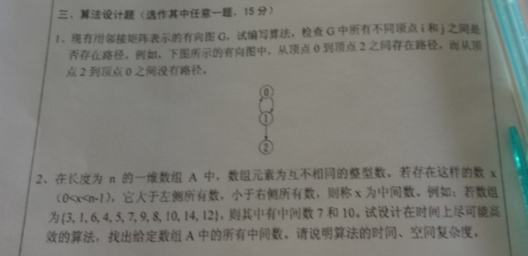
Where have we been？
  Exam problem:
    Given an array, find all “median numbers”
      before which the number is smaller and after which the number after is larger
  Reading
  100 people
  1 light bulb in a room
  Light off
  System: call each to access the room
  Q: How to design protocol to index that all people have accessed
Think in another way

Slide 13
Where have we been？
  Exam problem:
    Given an array, find all “median numbers”
      before which the number is smaller and after which the number is larger
    Code ?
    ALG → code?
    Why challenge?
    O(n^n), O(n^2), O(nlogn), O(n)
    Artificial for time?
      Purpose of exam
      In practice
  Reading
  100 people
  1 light bulb in a room
  Light off
  System: call each to access the room
  Q: How to design protocol to index that all people have accessed
Think in another way

Slide 14

Don’t make it complex,
Observe it & make it simple!

Slide 15
Let’s play! one game

Slide 16
Mobile System, mechanism design and competitiveness
Rule 1: answering and “claim your name”
Notes:
Combinatorial Optimization in Action
Flying a plane, riding a bus, buying a writing pad, or making a
phone call: Can you imagine that combinatorial optimization has
something to do with these activities? This lecture will provide
answers and show how the techniques of discrete mathematics
influence our daily life.
Combinatorial optimization in action
Combinatorial optimization exploded on the mathematical and scientific scene in the 1950s. In this lecture I will briefly survey its development for a wide audience. Theoretical design and analysis of algorithms dominated the early development of the field, while computational progress has been particularly significant in the last twenty years. These theoretical and computational achievements, combined with successful modeling of applications, have made it possible today to solve real-world problems of breathtaking size and diversity. The majority of the lecture will report on success stories in areas such as telecommunication, transportation, traffic and logistics. These results are based on ongoing cooperation between industry, the DFG Research Center MATHEON and my research group at Konrad-Zuse-Zentrum (ZIB).

Slide 17
Kick off: protocol/alg design
Black-box Game
  100 people
  light bulbs in a room; u can turn on/off
  Light off
  System: call each to access the room
  Blind to other’s behavior
  Q: how many bulbs should we need to index that all people have accessed

Slide 18
Kick off: protocol/alg design
Black-box Game
  100 people
  1 light bulb in a room
  Light off
  System: call each to access the room
  Blind to other’s behavior
  Q: How to design protocol to index that all people have accessed
No more tips but yes/no

Slide 19
What is your gain here:
observations and applications
team work
the way of thinking
is creativity

Slide 20
What is your gain here:
observations and applications
team work
the way of thinking
is creativity
The reason for caring of the time?

Slide 21
Some misunderstandings:
algorithm & sorting/data structure
algorithm analysis & algorithm time analysis
algorithm analysis & math: hard
learn algorithm vs investigate algorithm
algorithm analysis vs algorithm design

Slide 22
ALG: why am I here？

Slide 23
ALG: why am I here？
--credits, scores, graduation/degree, knowledge, jobs, …

Slide 24
“motivation”:
purpose: credits/degree → jobs vs skills→ curiosity/ambition
skill vs ability

Slide 25
Mobile System, mechanism design and competitiveness
1st Survey: # of job plans
“engineer”、
“体制内”、
“startup”、
“researcher/expert”
others…
Notes:
Combinatorial Optimization in Action
Flying a plane, riding a bus, buying a writing pad, or making a
phone call: Can you imagine that combinatorial optimization has
something to do with these activities? This lecture will provide
answers and show how the techniques of discrete mathematics
influence our daily life.
Combinatorial optimization in action
Combinatorial optimization exploded on the mathematical and scientific scene in the 1950s. In this lecture I will briefly survey its development for a wide audience. Theoretical design and analysis of algorithms dominated the early development of the field, while computational progress has been particularly significant in the last twenty years. These theoretical and computational achievements, combined with successful modeling of applications, have made it possible today to solve real-world problems of breathtaking size and diversity. The majority of the lecture will report on success stories in areas such as telecommunication, transportation, traffic and logistics. These results are based on ongoing cooperation between industry, the DFG Research Center MATHEON and my research group at Konrad-Zuse-Zentrum (ZIB).

Slide 26
Mobile System, mechanism design and competitiveness
1st Survey: # of job plans
“engineer”、
“startup”、
“researcher/expert”
“goverment employee”、
others…
Notes:
Combinatorial Optimization in Action
Flying a plane, riding a bus, buying a writing pad, or making a
phone call: Can you imagine that combinatorial optimization has
something to do with these activities? This lecture will provide
answers and show how the techniques of discrete mathematics
influence our daily life.
Combinatorial optimization in action
Combinatorial optimization exploded on the mathematical and scientific scene in the 1950s. In this lecture I will briefly survey its development for a wide audience. Theoretical design and analysis of algorithms dominated the early development of the field, while computational progress has been particularly significant in the last twenty years. These theoretical and computational achievements, combined with successful modeling of applications, have made it possible today to solve real-world problems of breathtaking size and diversity. The majority of the lecture will report on success stories in areas such as telecommunication, transportation, traffic and logistics. These results are based on ongoing cooperation between industry, the DFG Research Center MATHEON and my research group at Konrad-Zuse-Zentrum (ZIB).

Slide 27
Mobile System, mechanism design and competitiveness
2st Survey: # of study plans
“hungting jobs”、
“startup”、
“graduate study”、
others…
Notes:
Combinatorial Optimization in Action
Flying a plane, riding a bus, buying a writing pad, or making a
phone call: Can you imagine that combinatorial optimization has
something to do with these activities? This lecture will provide
answers and show how the techniques of discrete mathematics
influence our daily life.
Combinatorial optimization in action
Combinatorial optimization exploded on the mathematical and scientific scene in the 1950s. In this lecture I will briefly survey its development for a wide audience. Theoretical design and analysis of algorithms dominated the early development of the field, while computational progress has been particularly significant in the last twenty years. These theoretical and computational achievements, combined with successful modeling of applications, have made it possible today to solve real-world problems of breathtaking size and diversity. The majority of the lecture will report on success stories in areas such as telecommunication, transportation, traffic and logistics. These results are based on ongoing cooperation between industry, the DFG Research Center MATHEON and my research group at Konrad-Zuse-Zentrum (ZIB).

Slide 28
Mobile System, mechanism design and competitiveness
2nd Q: how much can ALG change me?
Notes:
Combinatorial Optimization in Action
Flying a plane, riding a bus, buying a writing pad, or making a
phone call: Can you imagine that combinatorial optimization has
something to do with these activities? This lecture will provide
answers and show how the techniques of discrete mathematics
influence our daily life.
Combinatorial optimization in action
Combinatorial optimization exploded on the mathematical and scientific scene in the 1950s. In this lecture I will briefly survey its development for a wide audience. Theoretical design and analysis of algorithms dominated the early development of the field, while computational progress has been particularly significant in the last twenty years. These theoretical and computational achievements, combined with successful modeling of applications, have made it possible today to solve real-world problems of breathtaking size and diversity. The majority of the lecture will report on success stories in areas such as telecommunication, transportation, traffic and logistics. These results are based on ongoing cooperation between industry, the DFG Research Center MATHEON and my research group at Konrad-Zuse-Zentrum (ZIB).

Slide 29
Some misunderstandings:
acm competition, MCM, etc & algorithm expect
what skill: programming vs algorithm
algorithm analysis & algorithm time analysis
your advisor vs your achievement
algorithm analysis & math analysis: hard

Slide 30
Mobile System, mechanism design and competitiveness
3rd Q: how far can I, an undergraduate student, go?
Notes:
Combinatorial Optimization in Action
Flying a plane, riding a bus, buying a writing pad, or making a
phone call: Can you imagine that combinatorial optimization has
something to do with these activities? This lecture will provide
answers and show how the techniques of discrete mathematics
influence our daily life.
Combinatorial optimization in action
Combinatorial optimization exploded on the mathematical and scientific scene in the 1950s. In this lecture I will briefly survey its development for a wide audience. Theoretical design and analysis of algorithms dominated the early development of the field, while computational progress has been particularly significant in the last twenty years. These theoretical and computational achievements, combined with successful modeling of applications, have made it possible today to solve real-world problems of breathtaking size and diversity. The majority of the lecture will report on success stories in areas such as telecommunication, transportation, traffic and logistics. These results are based on ongoing cooperation between industry, the DFG Research Center MATHEON and my research group at Konrad-Zuse-Zentrum (ZIB).

Slide 31

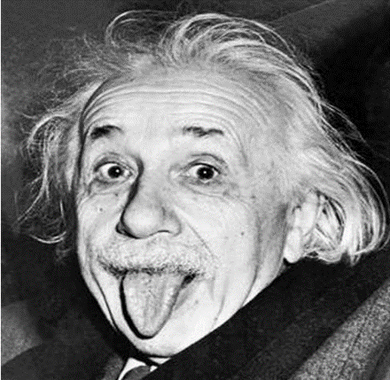
Discussion:
more
Young?
algorithm analysis & algorithm time analysis
your advisor vs your achievement
algorithm analysis & math analysis: hard

Slide 32

Discussion:
more
Young?
Hard? curiosity/ambition
algorithm analysis & algorithm time analysis
your advisor vs your achievement
algorithm analysis & math analysis: hard

Slide 33

Discussion:
Young?
Hard? curiosity/ambition
algorithm analysis & algorithm time analysis
your advisor vs your achievement
algorithm analysis & math analysis: hard

Slide 34
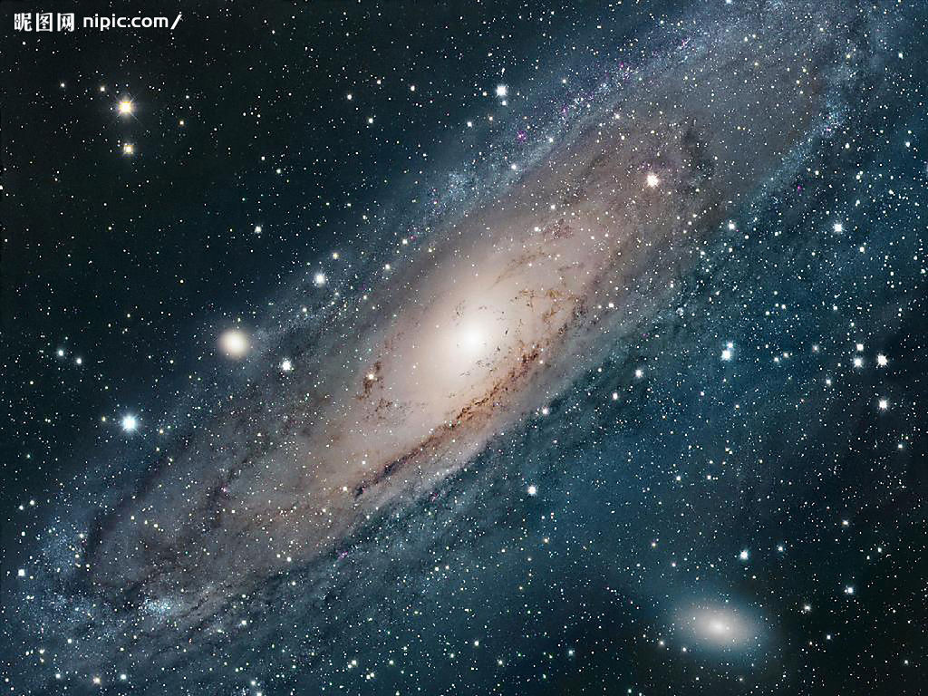
Discussion:
more

Slide 35
Algorithmic abilities in problem solving
√
survey,
general reading，
summarize，
extract，
technical reading,
adaptive，
discuss/present，
design，
analysis guided design，
data confirm，
analysis and confirm，
apply/communication and sail your goods/yourself (conference and travel)，
√
√
√
√
√
√
√
√
√
this lecture
alg expert scientist
Senior programmer

Slide 36
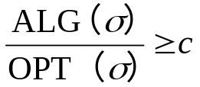
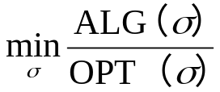




About the lecture
Motivation
  Thinking
  Bridge between engineering and expect (depth)
  Expression and surveying ability
  cooperation
Content survey & reading
  Fundamental/experience
  Planning & solutions
Requirement
  Thinking
  Participate (interactive)
Rule
  Attending, Q&A
  Grouping & grading
  Excise or competition
  Prerequisite
  Excises
    On-class Qs
    Problem sets
  Textbook
  Grading policy
  Collaboration policy
  Presentation
  Grouping
min problem, c-approximation:

Slide 37
About the lecture
Textbooks
1. Introduction to Algorithms, R. Charles, E. Leiserson T. H. Cormen, The MIT Press Cambridge
2. Algorithm Design, J. Kleinberg, É. Tardos, Addison-Wesley Press
min problem, c-approximation:

Slide 38
Grouping

Slide 39
Mobile System, mechanism design and competitiveness
Play again: make it simpler
Notes:
Combinatorial Optimization in Action
Flying a plane, riding a bus, buying a writing pad, or making a
phone call: Can you imagine that combinatorial optimization has
something to do with these activities? This lecture will provide
answers and show how the techniques of discrete mathematics
influence our daily life.
Combinatorial optimization in action
Combinatorial optimization exploded on the mathematical and scientific scene in the 1950s. In this lecture I will briefly survey its development for a wide audience. Theoretical design and analysis of algorithms dominated the early development of the field, while computational progress has been particularly significant in the last twenty years. These theoretical and computational achievements, combined with successful modeling of applications, have made it possible today to solve real-world problems of breathtaking size and diversity. The majority of the lecture will report on success stories in areas such as telecommunication, transportation, traffic and logistics. These results are based on ongoing cooperation between industry, the DFG Research Center MATHEON and my research group at Konrad-Zuse-Zentrum (ZIB).

Slide 40
Kick off: protocol/alg design
Black-box Game
  100 people
  light bulbs in a room
  Light off
  System: call each to access the room
  Blind to other’s behavior
  Q: how many bulbs should we need to index that all people have accessed

Slide 41
Kick off: protocol/alg design
Black-box Game
  100 people
  1 light bulb in a room
  Light off
  System: call each to access the room
  Q: How to design protocol to index that all people have accessed
Think in another way: holding balls each

Slide 42
Kick off: protocol/alg design
Black-box Game
  100 people
  1 light bulb in a room
  Light off
  System: call each to access the room
  Q: How to design protocol to index that all people have accessed
Think in another way
What if initial on/off is unknown

Slide 43
Kick off: protocol/alg design
Black-box Game
  100 people
  1 bulb in a room
  Light off
  System: call each to access the room
  Q: How to design protocol to index that all people have accessed
Think in another way
What if initial on/off is unknown
Application: threads/lightweight process in OS

Slide 44
What is your gain here:
make it simpler
the way of thinking
is creativity

Slide 45
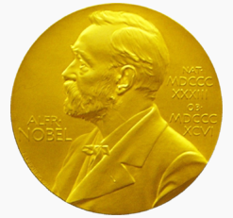
Topics and Syllabus
Introduction to ALG
Divide and conquer I: sorting
Divide and conquer II
Game I: equilibrium
Game II: auction
Greedy I
Greedy II
Dynamic programming I
Dynamic programming II
Flow
Approxi I
Stable concept
Approxi II
Online I: amortized analysis
NP-hard reduction
Online II: approaching the future

Slide 46
Our Syllabus
Introduction to ALG
Divide and conquer I: sorting
Divide and conquer II
Greedy I
Greedy II
Dynamic programming I
Dynamic programming II
Game I: equilibrium
Game II: auction
Flow
Approxi I
Stable concept
Approxi II
Online I: amortized analysis
Online II: approaching the future
NP-hard reduction
预备知识
递归与分治
动态规划
贪心算法
回溯法?
分支界限法?
概率算法
线性规划与网络流
NP-完全理论与近似算法

Slide 47
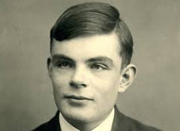
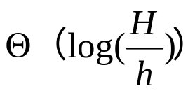

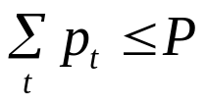



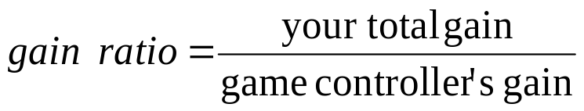
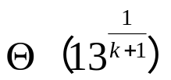
Turing people & alg
Turing Price
  Nobel price in computer science
22/57
  algorithmic theory
E.g.
1972，Edsger W.Dijkstra，shortest path
1974，Donald E.Knuth， LR(k), tex
1978，Robert W.Floyd, shortest path dp, heap-sort
1980，C. Anthony Hoare，quicksort
1982，Steven A.Cook，NP-complete
1985，Richard M.Karp，max flow
1986，John E.Hopcroft, Robert E.Tarjan, big O, amortized analysis
1994, John Nash, nash equilibrium
2000，Andrew Yao, Yao’s minimax, randomization
…

Slide 48
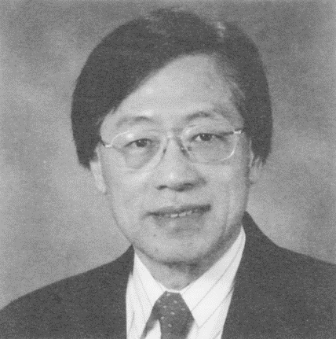
Turing people & alg
Turing Price
  Nobel price in computer science
22/57
  algorithmic theory
E.g.
1972，Edsger W.Dijkstra，shortest path
1974，Donald E.Knuth， LR(k), tex
1978，Robert W.Floyd, shortest path dp, heap-sort
1980，C. Anthony Hoare，quicksort
1982，Steven A.Cook，NP-complete
1985，Richard M.Karp，max flow
1986，John E.Hopcroft, Robert E.Tarjan, big O, amortized analysis
1994, John Nash, nash equilibrium
2000，Andrew Yao, Yao’s minimax, randomization
…
Andrew Yao

Slide 49
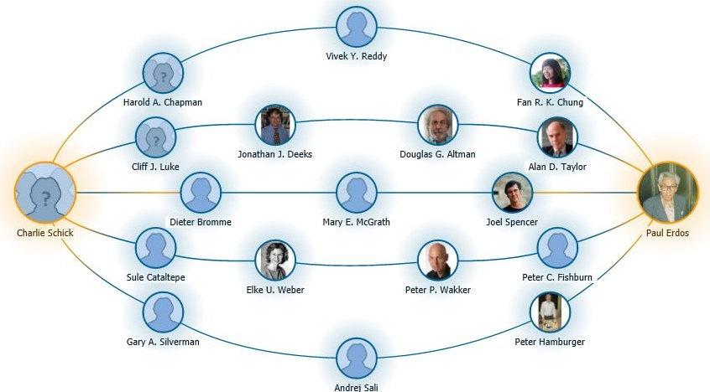
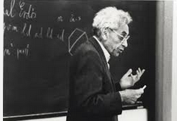
Turing people & alg
Turing Price
  Nobel price in computer science
22/57
  algorithmic theory
E.g.
1972，Edsger W.Dijkstra，shortest path
1974，Donald E.Knuth， LR(k), tex
1978，Robert W.Floyd, shortest path dp, heap-sort
1980，C. Anthony Hoare，quicksort
1982，Steven A.Cook，NP-complete
1985，Richard M.Karp，max flow
1986，John E.Hopcroft, Robert E.Tarjan, big O, amotized analysis
1994, John Nash, nash equilibrium
2000，Andrew Yao, Yao’s minimax, randomization
…
Erdos
Erdos number
E.g. Andrew’s erdos #=2
Andrew Yao-Graham-Erdos
W.Wu-M.Li-F.Yao-Erdos
W. Wu-M.Li-Andrew Yao-Graham-Erdos

Slide 50
Recap: big O, Ω
T(n)= O(f(n))：
  If there exists c > 0 & integer n_0≥1，such that T(n)≤c*f(n) for any n≥n_0
  e.g. T(n)=3n^3+2n^2，… , ∴T(n)= O(n^3)
Ω ?

Slide 51
Recap: big O, Ω
T(n)= O(f(n))：
  If exists c > 0 & integer n_0≥1，such that T(n)≤c*f(n) for any n≥n_0
  e.g. T(n)=3n3+2n2，… , ∴T(n)= O(n3)
Ω

Slide 52
Why poly(n) important
E.g. 10^9/s，n=60
complexity n n^2 n^3 n^5 2^n 3^n
Time: 6*10-8s 3.6*10-6s 2.16*10-4s 0.013min 3.66century 1.3*1013century
E.g. 10^9/s，n=10000
?

Slide 53
Why poly(n) important
E.g. 10^9/s，n=60
complexity n n^2 n^3 n^5 2^n 3^n
Time: 6*10-8s 3.6*10-6s 2.16*10-4s 0.013min 3.66century 1.3*1013century
E.g. 10^9/s，n=10000
?
E.g. 10^9/s，n=1000000
？

Slide 54
Why poly(n) important
E.g. 10^9/s，n=60
complexity n n^2 n^3 n^5 2^n 3^n
Time: 6*10-8s 3.6*10-6s 2.16*10-4s 0.013min 3.66century 1.3*1013century
E.g. 10^9/s，n=10000
?
E.g. 10^9/s，n=1000000
?
big data
?

Slide 55
Why poly(n) important
E.g. 10^9/s，n=60
complexity n n^2 n^3 n^5 2^n 3^n
Time: 6*10-8s 3.6*10-6s 2.16*10-4s 0.013min 3.66century 1.3*1013century
E.g. 10^9/s，n=10000
?
E.g. 10^9/s，n=1000000
?
big data
?
Data center?
m* 10^9/s vs n^r

Slide 56
Possible solving directions
If the problem is poly(n) computable
  Find polynomial time algorithms
  Reduce the time complexity : O(n^2)→O(n^logn)
  Find approximate solution with even faster algorithm
If the problem is difficult
  Prove the problem is NP-hard (mostly)
  Find polynomial time approximation algorithms
    tradeoff the gain with time
  Improve approximation ratio
  Find PTAS → (1+ε) – approximation (weak poly)
  Find FPTAS → (1+ε) – approximation (strong poly)
Prove the hardness of approximation

Slide 57
Simplified survey and presentation task
Read and study newest paper
  group name, evernote
  Choose from paper listed from (INFOCOM, ICDCS13’-14’) or found by yourself
  Read in depth
Report
  Includes: using your own language
    Problem background
    Survey related works, progress in the community
    Introduce the problem
    Introduce the solutions: including algorithms and proofs, idea of design and idea of proof, reason of the design, reason of the analysis
  Submission: PDF file
Present to others
  Submission: presentation slides, PPT file
  Presentation (selected)
Grading:
  Final exam 70%
  30%
    Reading task: among which: PDF report + PPT slides
    On class:
Bonus: any independent improvement to the existing work → !!

Slide 58
Survey skill
google with key word; baidu
e.g. algorithm +your topic +optimal/approximation
scholar.google.com
e.g. # of cite, # of cited， to see the whole story
vpn

Slide 59
Network power allocation:
  Online sequence:
  Power budget:
  Time slot t: allocate
  Maximize:
Toy example: Porker game: you vs. game controller
  value range [1-13]
  each time 1 card is released (by game controller)
  n cards will be released one by one (eg. n=10, k=2)
  choose k cards at most
  maximize

Slide 60
Topic list
1. Interval scheduling (min, max, capacity, online, offline, min number of machine)
2. ad word related, ad auction
3. influence maximization (kdd submodular influence maximization，or max influence with relay？)
4. coalition game （Elkind Edith and his student,yair zick's）, nucleolus (integral and fractional matching and others combinatorial,e.g.spanning,sterner,maxcut )
5. rate-adaptive transmission, power allocation
6. energy transfer (recharging network/ cover set adjustable to min set cover=2D min-cost range cover
7. resource allocation with capacity (Wangxm) related with could computing vm allocaiton
8. rectangle packing (hanxin) max, min
9. strip packing, one axis fixed, related with storage allcoation
10. facility location
10.1. subaddititive，submodular，buyer truthful mechanisms
11.link scheduling/broadcast relay min energy/cost (Feng's talk)
12.mutiple knapsack, minimum knapsack, min diamjeter spanning tree （for me）/min delay relay /data agreegation tree/cost efficient （infocom2012，http://nms.citi.sinica.edu.tw/twkuo/ARP.pdf）13. truthful auction with demand related with cloud resource auction
14. max matching with capacity on nodes
15. max flow-->rate-adaptive flow ,unsplittable flow, 0/1 flow
16. min active time of job scheduling (data sharing)-->offline -->online -->DP optimal? 26.
17. shortest path (time-dependent, network?)
18. energy transfer, recharging network/EMR
19. machine resource allocation ,min makespan, ptas

Slide 61



Some basic concepts
NP-hard: reduction (hardness in time)
Algorithm analysis max problem, c-approximation:
  Approximation: offline bound, worst case analysis
    any input
    Poly vs. Exponential
  Competitive: online bound, immediate decision
    no future information
    Partial info vs. Full info & Poly vs. Exponential
Inapproximation: hardness in performance guarantee (lower bound)
Randomization helps？
min problem, c-approximation:

Slide 62
Concepts in Game theory:
Network power allocation:
  Online sequence:
  Power budget:
  Time slot t: allocate
  Maximize:
Toy example: Porker game: you vs. game controller
  value range [1-13]
  each time 1 card is released (by game controller)
  n cards will be released one by one (eg. n=10, k=2)
  choose k cards at most
  maximize
Nash Equilibrium and Dominant Strategy
  Equilibrium: →Game theory →Selfish behavior
  A status that users has no incentives to change
  Dominant: →Mechanism design →Cheating behavior
  A status (strategy) that user would like to choose ignoring others’ status

Slide 63
Mobile System, mechanism design and competitiveness
System view:
Notes:
Combinatorial Optimization in Action
Flying a plane, riding a bus, buying a writing pad, or making a
phone call: Can you imagine that combinatorial optimization has
something to do with these activities? This lecture will provide
answers and show how the techniques of discrete mathematics
influence our daily life.
Combinatorial optimization in action
Combinatorial optimization exploded on the mathematical and scientific scene in the 1950s. In this lecture I will briefly survey its development for a wide audience. Theoretical design and analysis of algorithms dominated the early development of the field, while computational progress has been particularly significant in the last twenty years. These theoretical and computational achievements, combined with successful modeling of applications, have made it possible today to solve real-world problems of breathtaking size and diversity. The majority of the lecture will report on success stories in areas such as telecommunication, transportation, traffic and logistics. These results are based on ongoing cooperation between industry, the DFG Research Center MATHEON and my research group at Konrad-Zuse-Zentrum (ZIB).

Slide 64
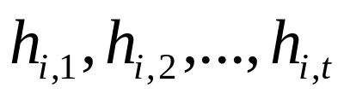
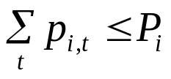

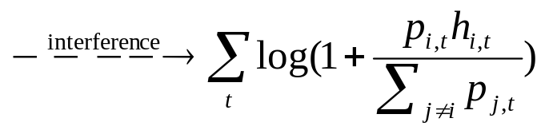
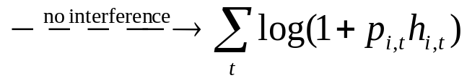
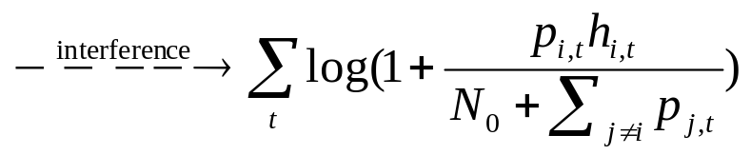
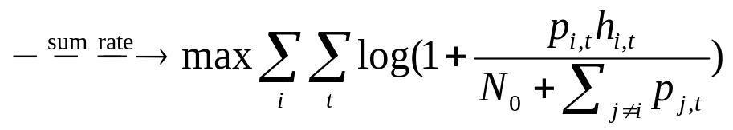
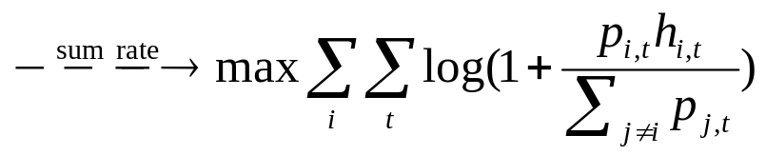
Mobile system: Data throughput
Power limited | Varying channel | Interference
Network power allocation: online decision
  Varying channel quality:
  Limited power:
  Time slot t: allocate
  Interference:
  Objective:
Network power allocation:
  Online sequence:
  Power budget:
  Time slot t: allocate
  Interference:
  Competition between users (each minimizes the workload)
  Objec
tive:

Slide 65

Target:
Network power allocation:
  Varying channel quality:
  Limited power:
  Time slot t: allocate
  Interference:
  Competitions between users (cheating on private info. )
        (each user wants to minimize his workload)
  Objective:
  Truthfulness?
  Game theory
        (system wants to max throughput)

Slide 66
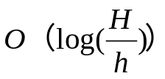
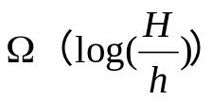
Target: two questions
Models: Interference Truthful | One-user × × | Multi-users √ × | Multi-users √ √
Upper bound (ALG) | Deterministic [Buchbinder 2009] | Randomized [Buchbinder 2010]
Lower bound | Deterministic [Buchbinder 2009]
Randomized
Randomized
Lower bound side: does randomization help in [Buchbinder 2010]?
        Answer: no!
Upper bound side: how much affection of truthfulness?
        Answer: we have some way to smooth away

Slide 67


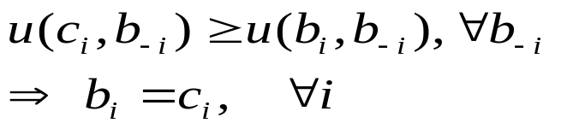
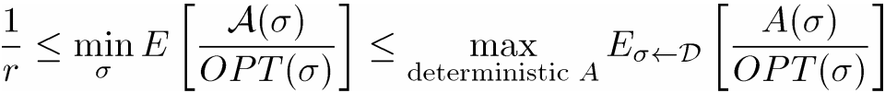
Technologies
Good
Mechanism M(A,P):
A: allocation (winner i)
P: payment (i pays p_{i})
Seller
bid:
Bidders:
Bidder i: max c_{i}-p_{i}
Value:
Algorithmic mechanism design
(e.g. Vickrey Auction) 96’
(e.g. Myerson) 07‘
Competitive analysis (Online study)
Yao’s minimax principle (Andrew C-C Yao, 1977) 00‘
Truthfulness
Randomized
Randomized

Slide 68

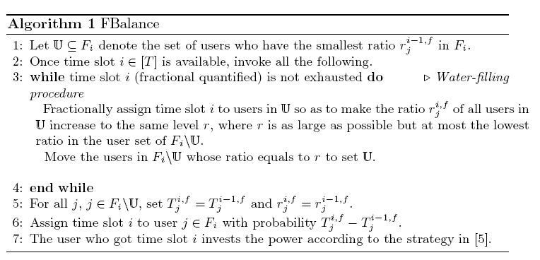
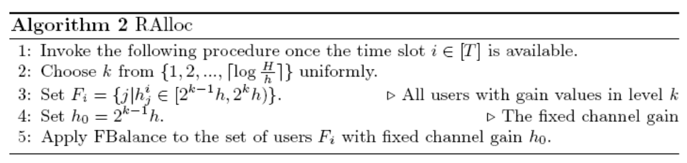
Mechanism/Algorithm
1235
34
23
123
        Time allocation (step 3-6)
        Power allocation (step 7)
Algorithmic mechanism design
(e.g. Vickrey Auction) 96’
(e.g. Myerson) 07‘
Competitive analysis (Online study)
Yao’s minimax principle (Andrew C-C Yao, 1977) 00‘
Truthfulness
1 2 3 4 5
Randomized
Randomized

Slide 69


Mechanism/Algorithm
Mechanism: M(Ralloc,P)
Truthfulness
Randomized
Call: FBalance(F_{i},h₀)
Randomized

Slide 70

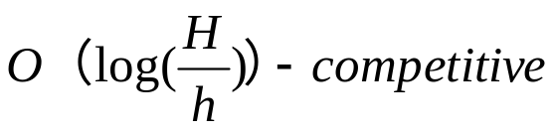
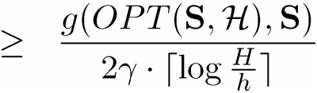

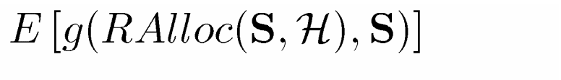
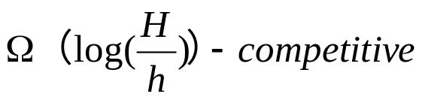
Our Results:
Algorithmic mechanism design
Competitive analysis
Yao’s minimax principle
Summary: truthful & optimal competitive
  a truthful mechanism M(Ralloc, P)
  Ralloc is
  Any randomized alg is

Slide 71
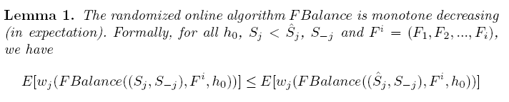
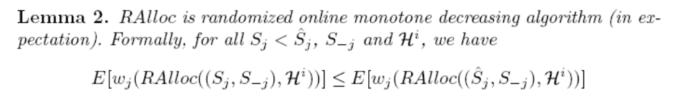
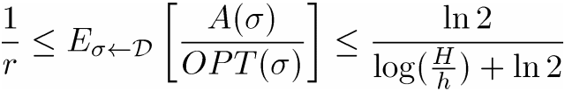
Proof sketch:
  (1) Mechanism M(Ralloc, P) is truthful.
1 2 3 4 5
  Truthfulness: applying the monotone-theorem in [Archer,FOCS01]
  Ralloc is
  Any randomized alg is

Slide 72



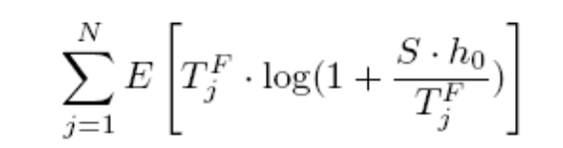
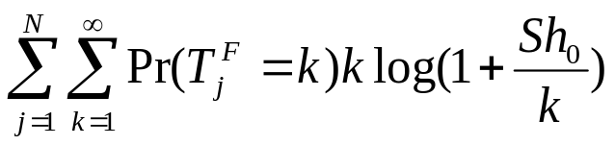
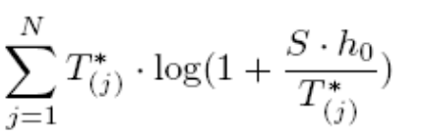

Proof sketch:
  (2) Ralloc is
  Ralloc
  FBalance
  OPT
  Ralloc is
  Any randomized alg is

Slide 73
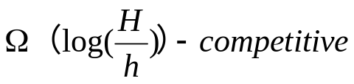
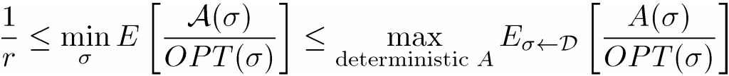
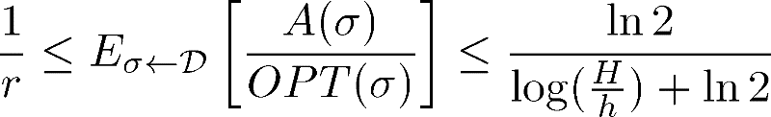




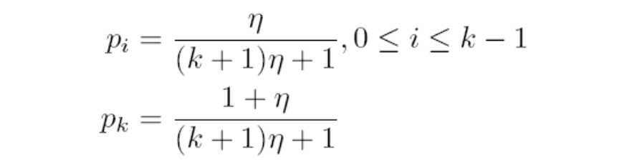





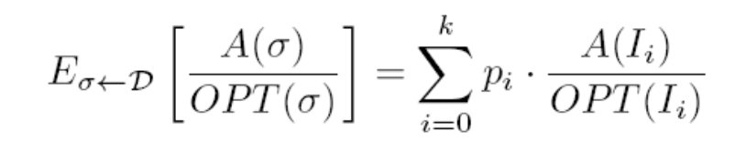
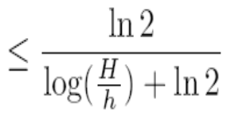
Proof sketch:
  (3) Any randomized (deterministic) algorithm is
  Goal:
  Minimax Principle:
  Constructed instances:
  Specify the distribution:
  …
  …
  Truthfulness: applying the monotone-theorem in [Archer,FOCS01]
  Ralloc is
  Any randomized alg is

Slide 74
Summary: truthful & impossible to be improved

Slide 75
Thank You!

Slide 76
Algorithmic abilities in problem solving
√
survey,
general reading，
summarize，
extract，
technical reading,
adaptive，
discuss/present，
design，
analysis guided design，
data confirm，
analysis and confirm，
apply/communication
sail your goods/yourself (conference and travel)，
√
√
√
√
√
√
√
√
√
√
lecture
algorithm researcher, scientist

